Slide 1


Slide 2


The game focuses on...
Casual players
Computer
Online multiplayer

Slide 3
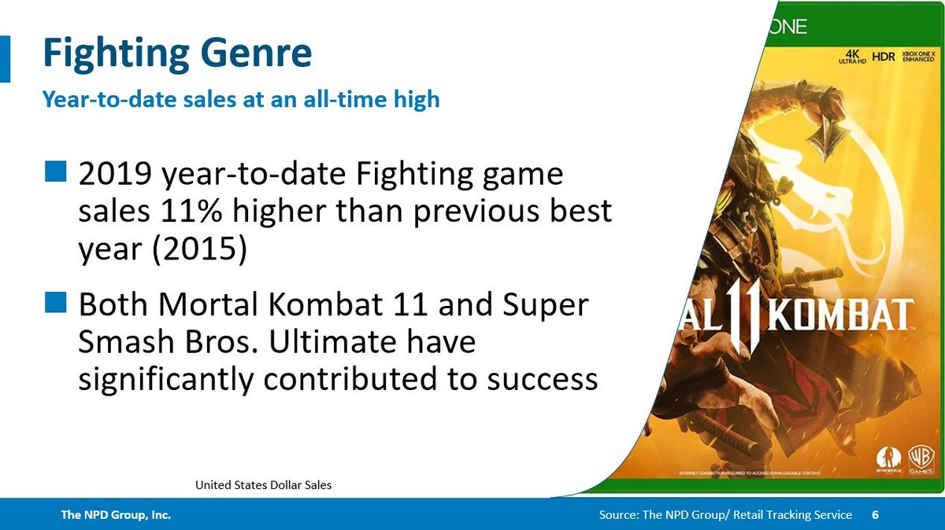
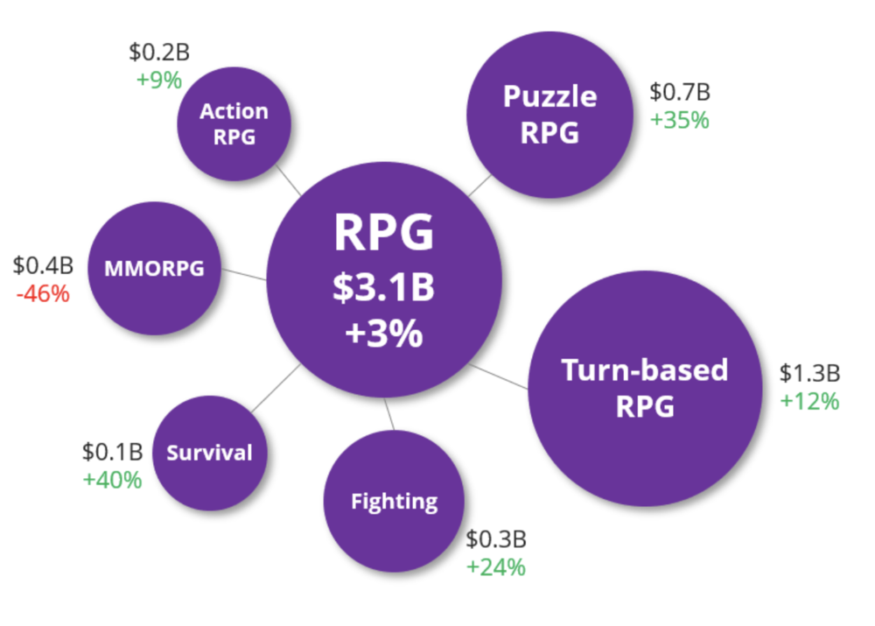
Year-to-date sales of fighting genre games are at an all-time high, with genre sales 11 percent higher than the previous year-to-date high set in 2015.(Mat Piscatella - November 14, 2019)
The mid-core market grew by 7% in 2018. The main bulk of growth was driven by Battle Royale and Puzzle RPG and Fighting Games while the biggest losers were Synchronous Battlers (aka. Clash Roayle) and MMORPG (aka. Lineage II). (Michail Katkoff – Februaru 2, 20)
Notes:
https://www.kitguru.net/tech-news/mustafa-mahmoud/2019-is-the-best-year-ever-for-fighting-games/
https://twitter.com/MatPiscatella/status/1195122321884897280
https://www.deconstructoroffun.com/blog/2019/2/2/2019-predictions-5-rpg-is-where-the-big-bucks

Slide 4
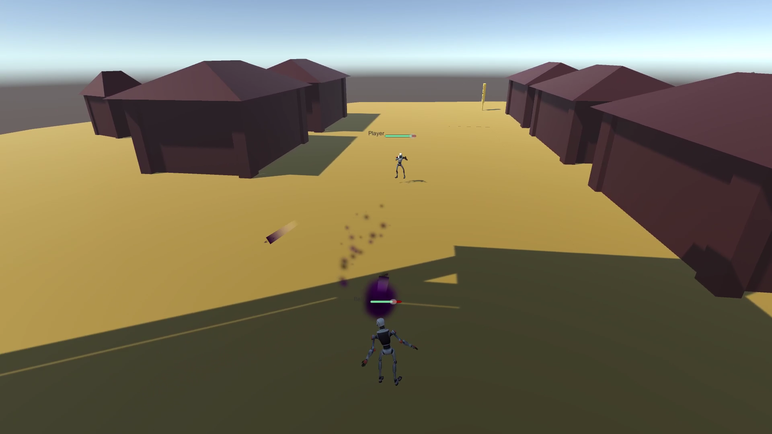
Our game is…
Fast
Easy
Diverse

Slide 5
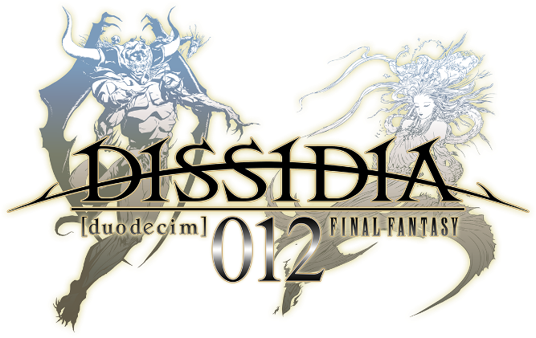

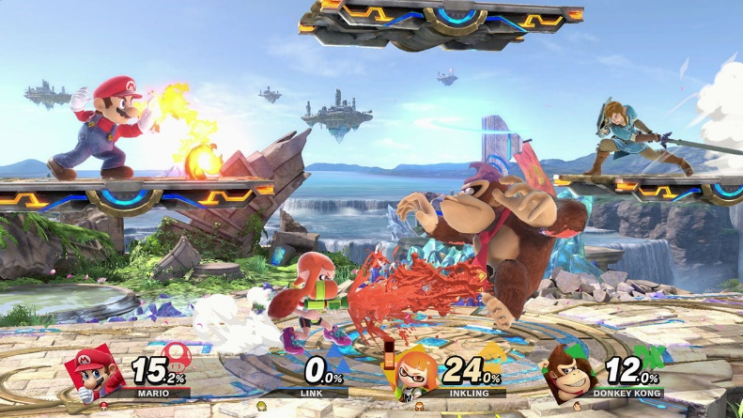
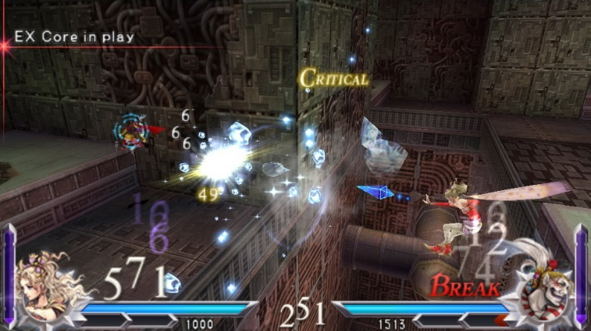
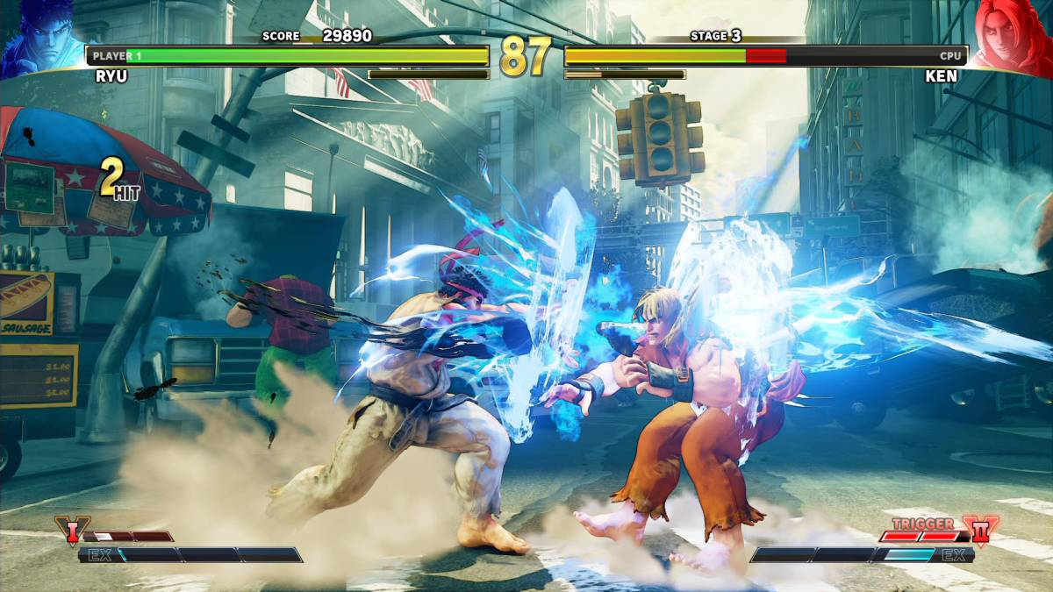
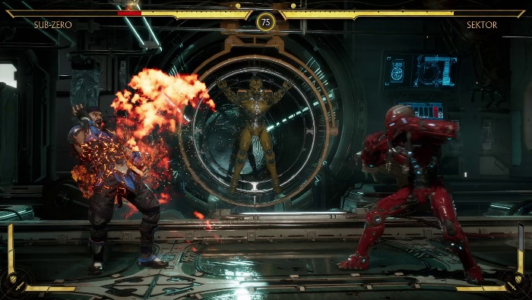
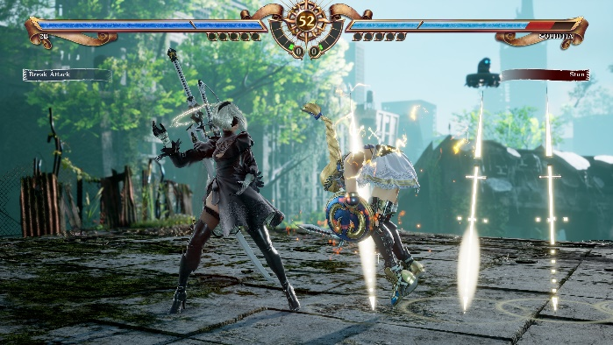
X
Most fighting games are 2D
Restrictive 3D alternatives
Flat stages
Complex controls

Slide 6
These awesome people are making the game!
Programming team:
Marc Segura Duran
Albert Martinez Oliver
Angel Farré Echaburua
Lead designer:
Eric Cugat Herraiz
Animation:
José Ignacio Alonso Engel

Slide 7
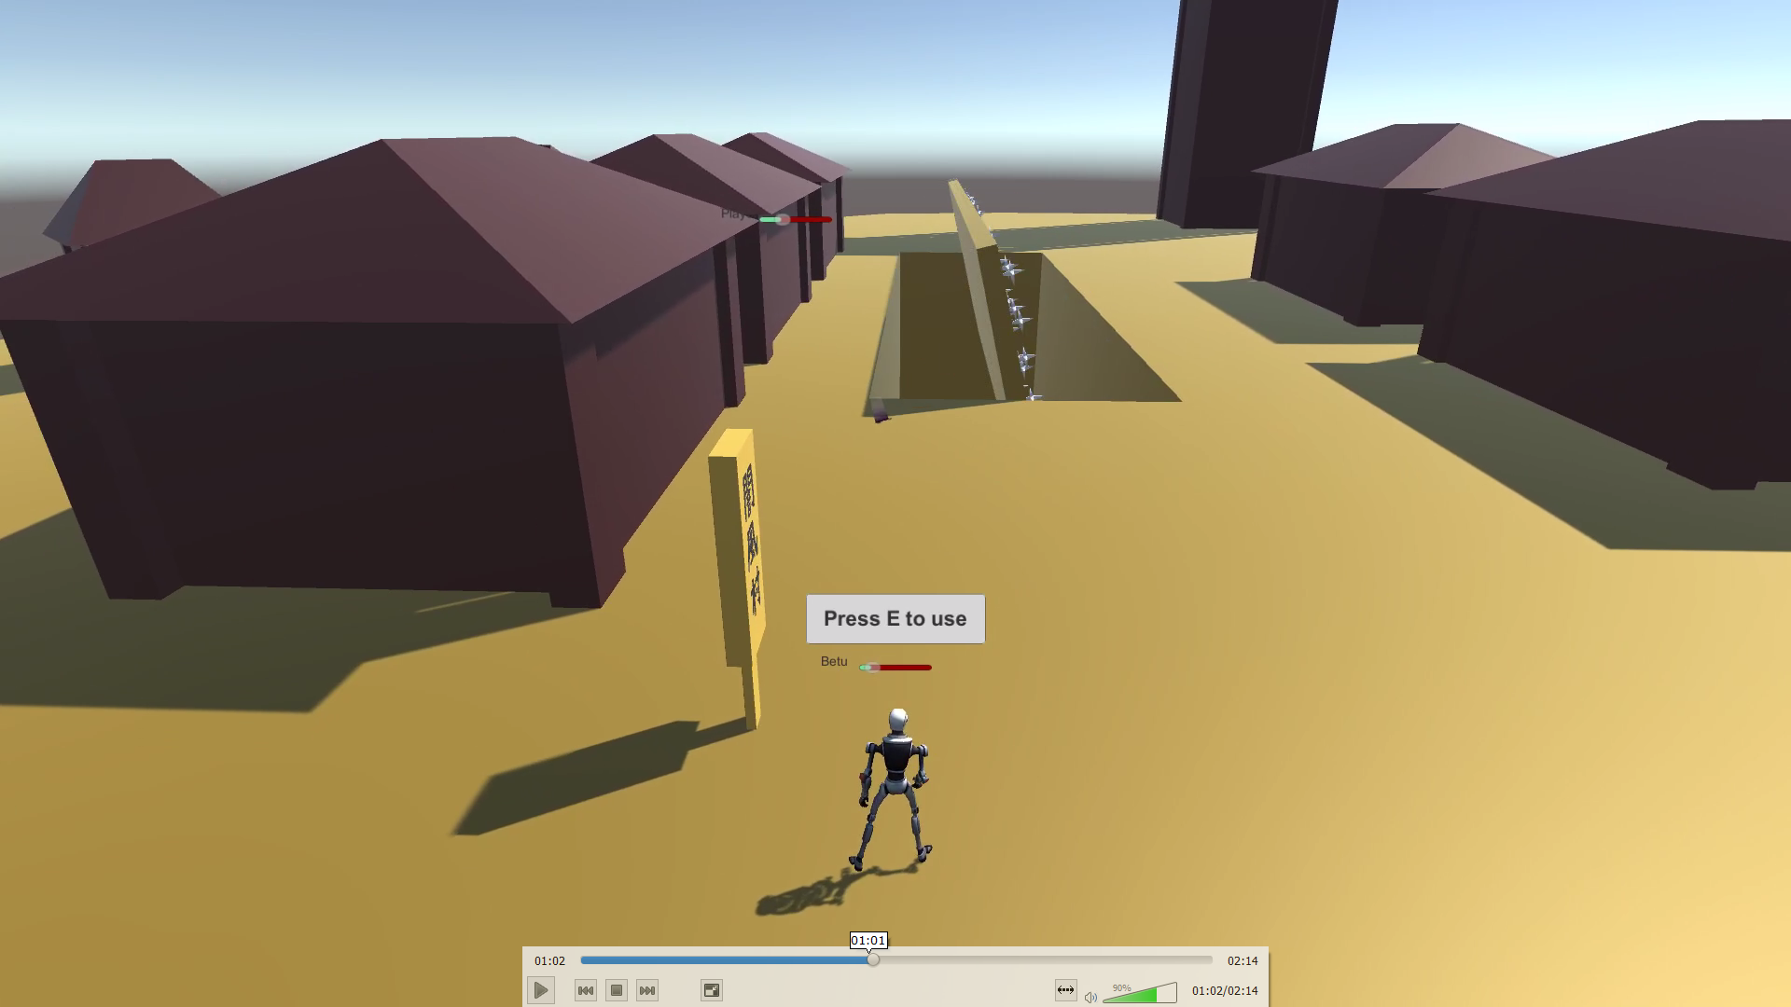
The game so far
Functional multiplayer
Functional matches
Interactive stage

Slide 8

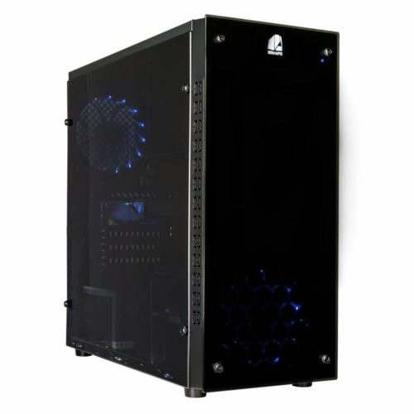

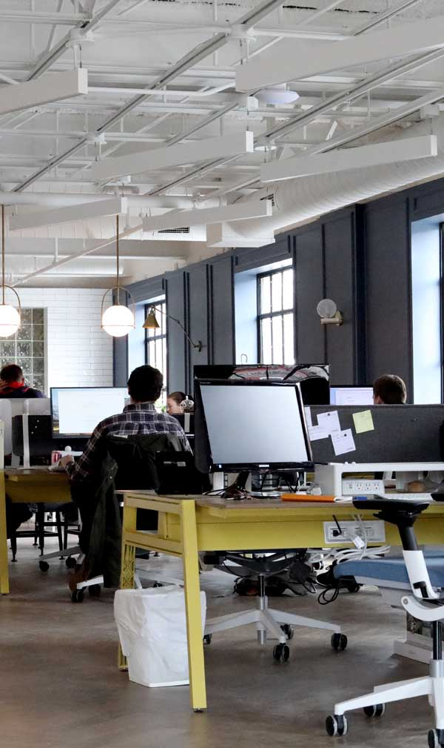


And the costs are...
Salary: around 14594€ per member
Computers: around 1000€ per PC
Unity Pro: 625€ x 5 members
3DSMax: 975€ x 5 members
Photoshop: 120€ x 5 members
Substance Painter Pro: 500€ x 5 members
Office to work: 2250€
Total: 91320 € for 5 months
Notes:
https://www.payscale.com/research/US/Job=Video_Game_Designer/Salary
https://mejorenpc.com/presupuestos-pc-gamer-2019/
https://store.unity.com/es/compare-plans
https://www.autodesk.com/products/3ds-max/subscribe?support=ADVANCED&plc=3DSMAX&term=1-YEAR&quantity=1
https://www.adobe.com/es/creativecloud/plans.html
https://www.substance3d.com/subscribe/
https://www.idealista.com/ca/inmueble/88082614/

Slide 9
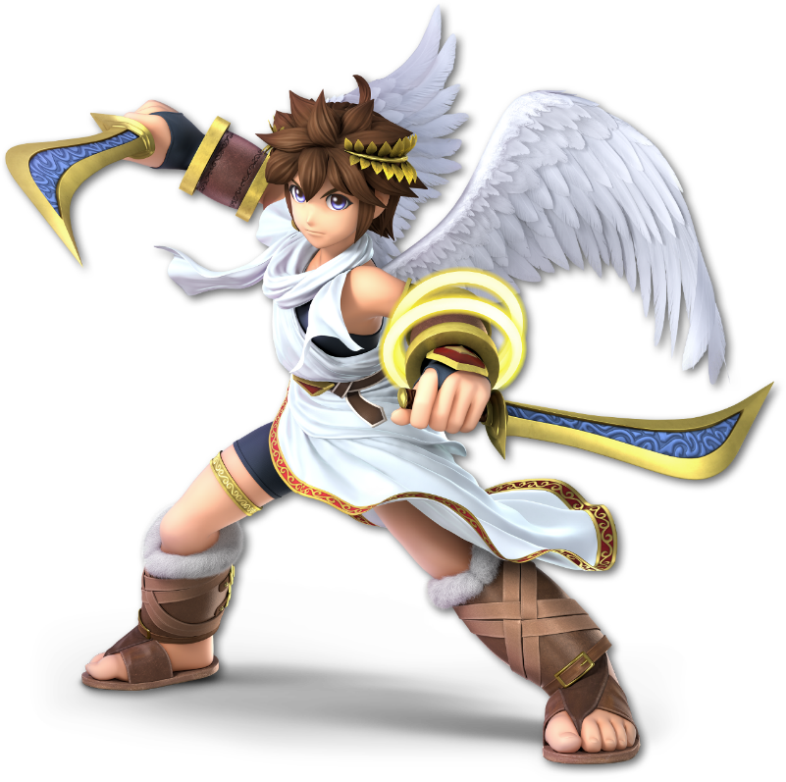
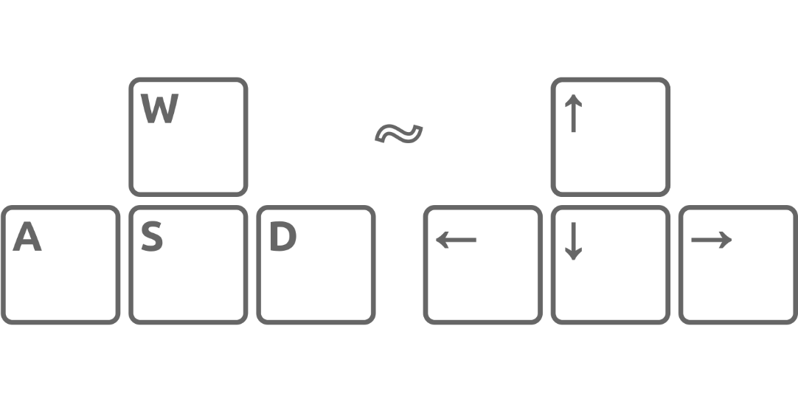

What’s next
Character models
Multiple in-game characters
Character balance
Game Settings customization
Additional maps
Fight animations

Slide 10
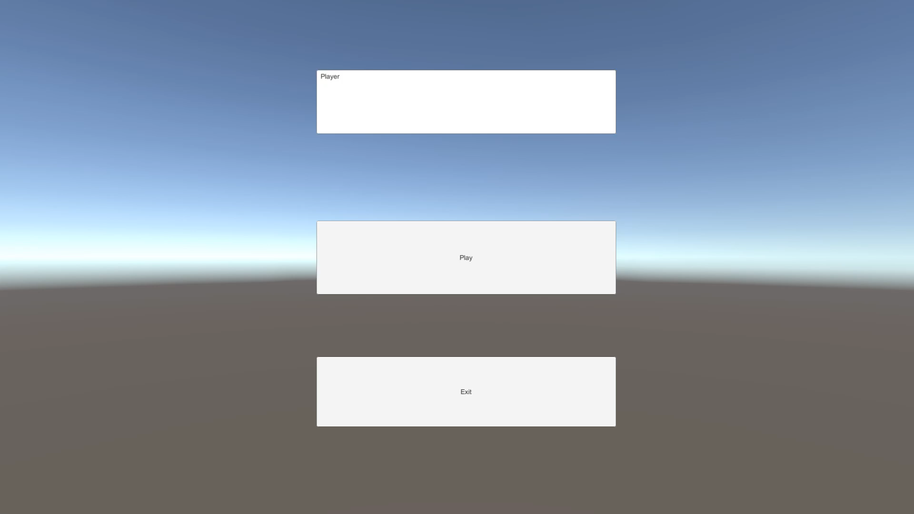
One last surprise

Slide 11


